Slide 1
World Wide Web data
By,
Prerana T H M
USC ID: 7795750397
Notes:
Slides can vary as per your presentation, but header and footer should be consistent

Slide 2
Why is this Big data?
WWW data or Internet data consists of all the URLs and DNS data of the world and also the contents in these URLs.
This data is stored on the hard drives of web servers all over the world.
The World Wide Web never "runs out of space" because webmasters (people who have websites) are generally willing to pay for a website, and that means that people in the web "hosting" business have the cash to pay for more web servers if they need them.

Slide 3
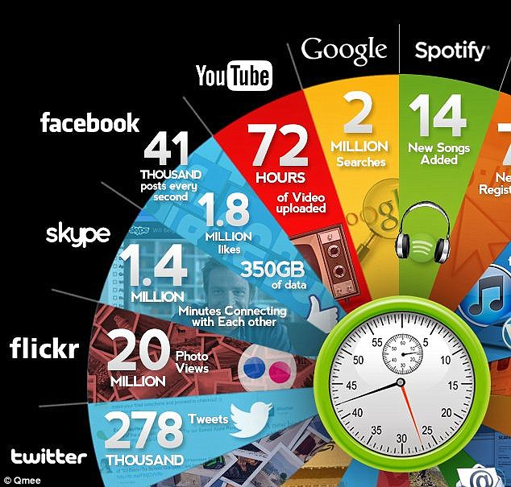
How big is it really?
Cashback site Qmee has created an infographic that shows how many tweets are sent, Facebook posts are liked, Skype calls are made and YouTube videos are viewed in a single minute across the internet. It used information and figures from PC Mag, Business Insider and other sites to create a 60-second snapshot.

Slide 4
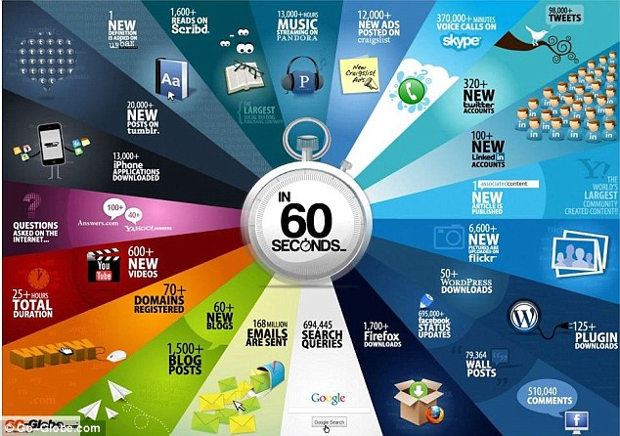
How big is it really?
Go-Globe.com designed a similar graphic in June last year. By comparison, the amount of emails sent has increased by 36million a minute. There are almost four times more Google searches than a year ago, and 180,000 more tweets are sent.

Slide 5
What about the 5 v’s?
1. Volume – HIGH
Since millions of user websites data is stored, volume is high
2. Velocity – HIGH
Lot of new websites are created every minute all across the world and lot of data transfer takes place.
3. Variety – HIGH
Different types of data is stored on the web. The DNS records are stored as CNAMEs and ANAMEs. Websites store data in many formats like HTML, Text, Images, Audio, Video etc.

Slide 6
What about the 5 v’s?
4. Veracity – MEDIUM
There are both legit and illegal websites out there on the internet and hence veracity is medium
5. Value – HIGH
Websites can be used for so many different purposes like social networking, banking, ticket booking, shopping, providing medical facilities etc. and therefore value is high

Slide 7
Unintended consequences
Since Website and domain creation is accessible to anyone and everyone, many people misuse this by creating illegal websites.
Malware is spread through many websites which can affect a network or personal computer and cause financial and information losses.
Phishing, spoofing, spamming can also be considered as one of the unintended consequences.

Slide 8
Questions?
Thank you!!!

